Slide 1
Data Science Project
Topic : Different Regression Models

Slide 2
Introduction
Name : Aman Kumar
Branch : CSE
SEM : 6th
Program :Data Science Project
Date : 03-05-2023

Slide 3
Linear Regression
Linear regression is a machine learning algorithm which is based on the supervised learning.
Linear regression is an analysis that assesses whether one or more predictor variable
explains the dependent variable.
Linear Regression model target’s prediction value based on independent variables.
Linear Regression is mostly used for finding out the relationship between variables and forecasting
Different regression models differs based on the kind of relationship between dependent and
independent variables, they are cindering and the number of independent variable being used.
.

Slide 4
Decision tree
Decision tree represent the features of a dataset, branches represent the decision rules
and each leaf node represents the outcome.
In a Decision Tree, there are two nodes which are the Decision Node and Leaf Node.
Decision nodes are used to make any decision and have multiple branches, whereas leaf
Nodes are the output of those decisions and do not contain any further branches.
The Decisions or the tests are performed on the basis of features of the given dataset.
It is a graphical representation for getting all the possible solutions to a problem/decision based on given conditions.
It can be very useful for solving decision-related problems.
There is less requirement of data cleaning compared to other algorithms.

Slide 5
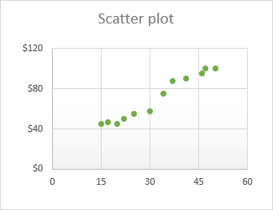
Scatter plot
Definition of Scatter plot:
Scatter plot or scattergrapgh is a type of mathematical diagram to display
values for two variables for a set of data.
A scatter plot is a graph made by plotting ordered pairs in a coordinate plane
to show the correlation betweeen two sets of data.
The data is displayed as a collection of points.
A scatter plot describes a positive trend if, as one set of value increases, the
other set trends to increase.

Slide 6
Formula for linear regression
Y=a +bX, where y is dependent variable and X is the explanatory
variable.
Also, a and b can be computed by the following formula :
b= {n ∑ xy−(∑x)(∑y)}/(n∑x2−(∑x)2)
and
a= ∑y−b(∑x)/n

Slide 7
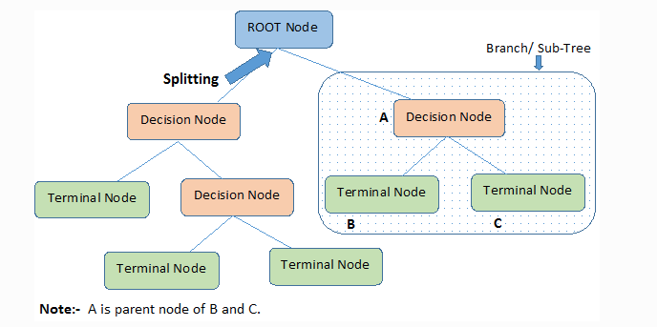
Decision Tree
In Decision Trees , for predicting a class label for a record
we start from the root of the tree
We Compare the values of the root attribute with the records attribute.
On the basis of comparision , we follow the branch corresponding
to that value and jump to the next node.

Slide 8
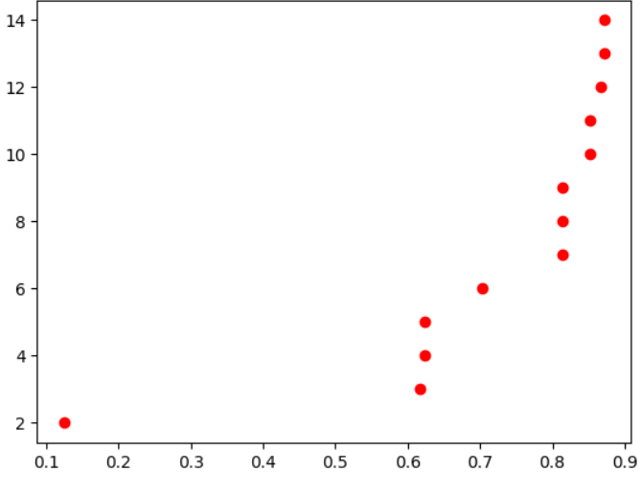
Result:
Accuracy from linear regression :
Accuracy from Decision Tree :
max_leaf_nodes ->
Accuracy ->

Slide 9
Conclusion:
In conclusion, after evaluating the performance of different machine learning models on
the given dataset, it was found that a linear regression model performed better than the
other models. The linear regression model was able to accurately predict the target
variable with a high degree of precision and generalization ability. Furthermore, the
model was able to capture the underlying relationships between the predictor variables
and the target variable, making it a suitable choice for this particular task. However, it's
important to keep in mind that the performance of a machine learning model is highly
dependent on the quality of the data and the features used, so it's crucial to carefully
preprocess the data and choose the appropriate features before training the model.

Slide 10
Thank you

